Slide 1
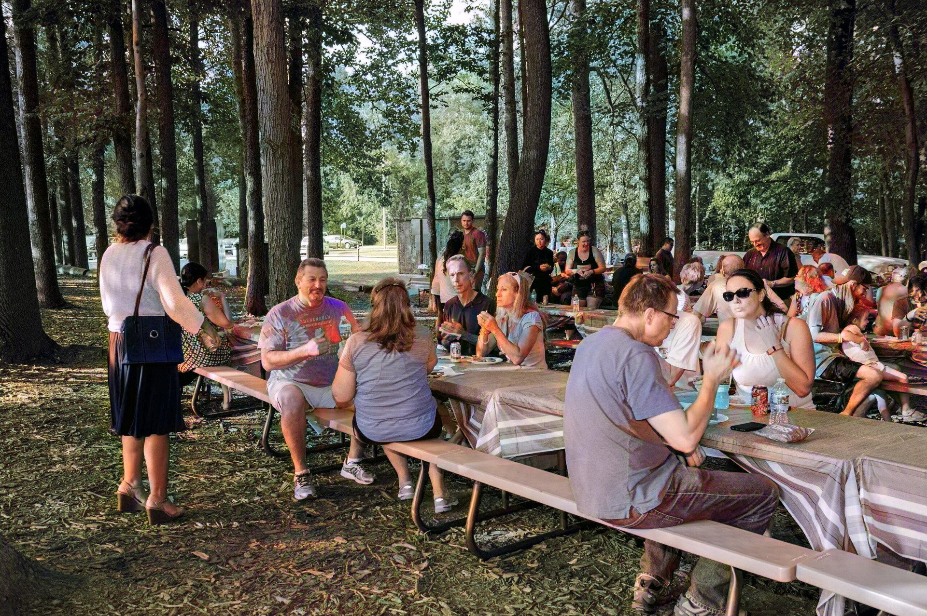




HOW TO PRODUCE
SMALL EVENTS
Notes:
Hello and welcome to FCPA’s “How to Produce Small Events” Presentation! I am______, a special events intern at FCPA, and I will be walking you through the process of creating your very own small FCPA event!

Slide 2
Table of Contents
Planning Roadmap
Introduction
6-4 Months Out
3 Months Out
2 Months Out
1 Month Out
2-1 Week(s) Out
Day of the Event
Debrief
Acknowledgements
2
3
4
7
11
12
13
14
15
16
Park Services | Fairfax County Park Authority
Notes:
Here’s the table of contents. If you need to refer to a page quicky, simply click the heading on the page (point to the headings on the page).

Slide 3








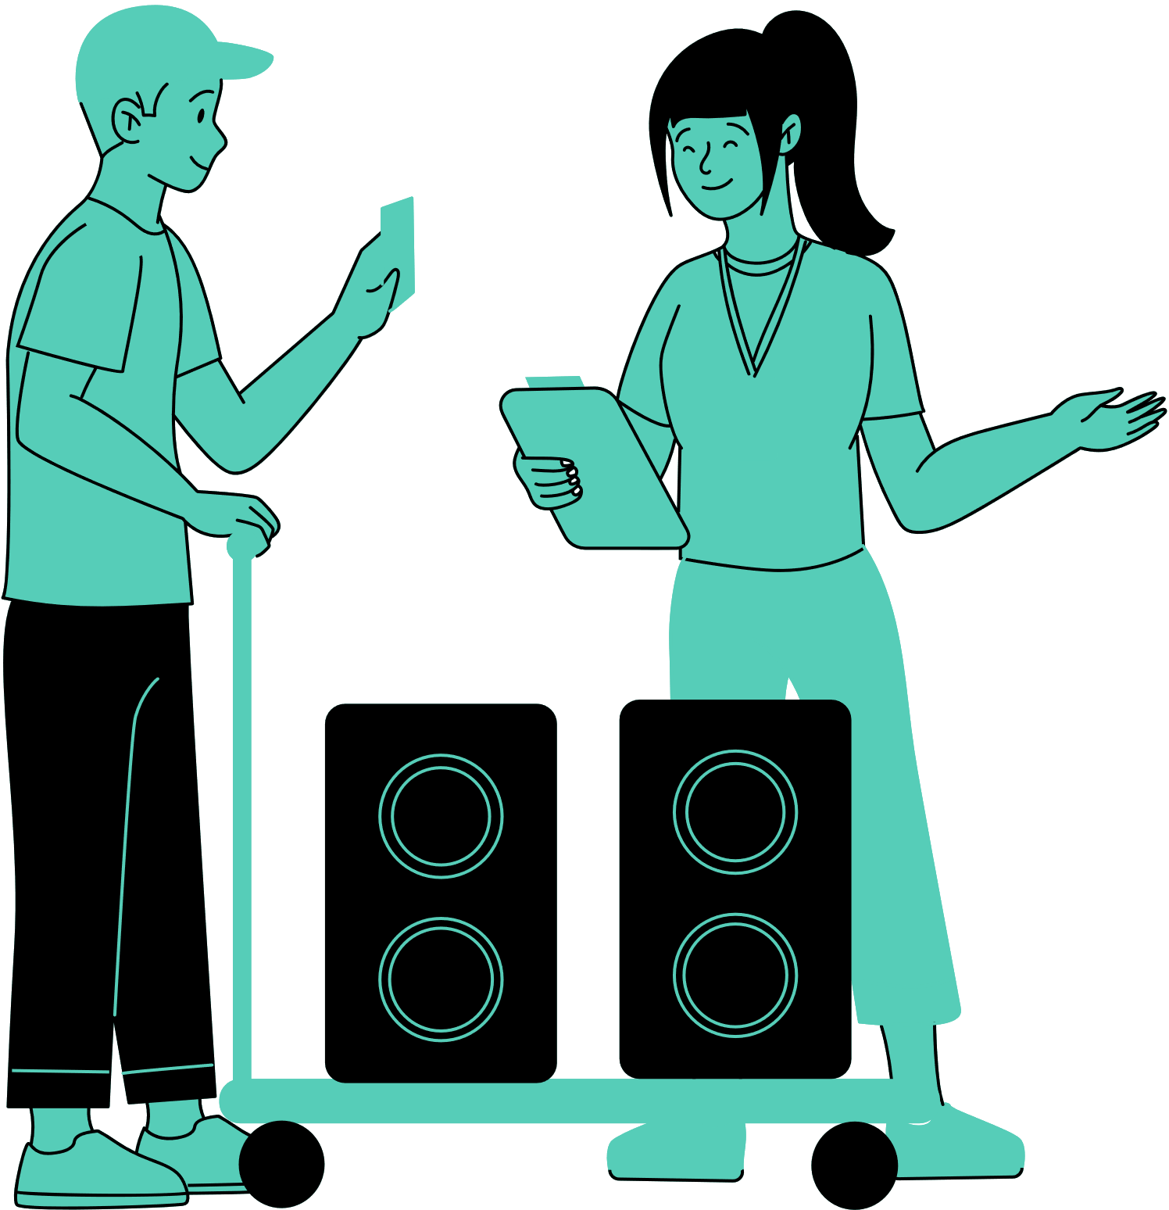
Small Event Planning Overview
Small events are categorized by any event under 500 attendees
Start 6-4 Months
6-4
6-4
  Establish your target audience
  Identify your planning team
  Create an estimated budget
  Send out marketing requests to MarComm
  Select a few possible dates
  Make an event outline
  Determine location
  Determine event size
3
  Finalize dates with your manager
  Do a site visit and determine safety exits
  Outline event layout and site plan
  Get all necessary equipment, vendors, and entertainers
  Plan for bathroom facilities
  Report the necessary updates of your event to your manager
3
2
2
  Design a show flow
  Finalize parking plans
  Finalize confirmations
1
1
  Monitor your registrations
  Schedule a meeting with your event team
  Prepare remarks
  Ensure the fliers and programs are edited and distributed properly
<1
  Finalize confirmations
  Monitor your registrations
  Monitor the weather
  Work through any expected equipment delays
<1
Day
of
  Continue to monitor the weather
  Set up your event based on your site plan and show flow
  Monitor your guests
Day
of
Contact
Shera White
shera.white@fairfaxcounty.gov
Park Services | Fairfax County Park Authority | 2
Notes:
Here’s the planning roadmap for small events. You can also reference this anytime you feel lost in this presentation. All of the bullet points of this presentation are condensed down to this infographic.

Slide 4


Introduction
Welcome to FCPA’s event planning process! You probably want to begin as soon as possible, but here’s a few things to think over before you get started.
01. Determine your event goals and objectives.
Before you begin filling out forms, write down specific event goals. Outline how this event will contribute to FCPA’s broader mission and values.
FCPA’s Mission Statement
To enrich quality of life for all members of the community through an enduring park system that provides a healthy environment, preserves natural and cultural heritage, offers inspiring recreational experiences, and promotes healthy lifestyles. To read more, go to the website.
Park Services | Fairfax County Park Authority | 3
Notes:
Although you might already know what event you would like to have, to help iron out the details of your event, it’s best to write down your specific event goals. Outline how this event will contribute to FCPA’s broader mission and values. To learn more about FCPA’s greater mission and values, click on this link here (point to the link on the page).

Slide 5

6-4 Months Out
01. Establish your target audience.
Is this event for county residents? Fairfax County staff? Have you had this event in the past? Can you estimate the size of your audience?
02. Identify your planning team.
Who needs to be there during the planning process? Who’s going to be the primary contact for the event? Who on your team is going to be at the event?
NOTE:
Make sure you have enough team members at the event. You should have enough people to help with set up and take down of the event.
03. Create an estimated budget.
Consider all items needed. Check in with your manager to see how much money you are able to use for your event.
04. Send out requests to MarComm.
If you require any marketing support for your event such as fliers, photographers, and/or ads in Parktakes, submit a request form to MarComm at least 6 months out.
Park Services | Fairfax County Park Authority | 4
Notes:
For small events, ideally start planning your event 6-4 months out to ensure you have ample time to complete the planning process without feeling the pressure of a time crunch. First, establish your target audience. Ask yourself who this event will be for. Is it for Fairfax County residents? Is this for FCPA staff? Fairfax County staff? Have you hosted and/or planned an event like this in the past? Has another department hosted an event like this in the past? If so, can you estimate the size of your audience based on the turn out of those previous events?
Please note that you should have enough team members on your event planning team and present on-site during the event. This will ease the stress for yourself and make the planning process less stressful all together.
Next, you should create an estimated budget plan.
If you want help marketing your event, reach out to the marketing and communications department (MarComm) for help with fliers, photographers, and/or ad placement in Parktakes. If you want to have your event featured in Parktakes, you must submit a request form at least 6 months in advance. Click on MarComm here [click on link] to find MarComm’s Sharepoint page for more information.

Slide 6


6-4 Months Out
05. Select a few possible dates.
Check for potential conflicts with other FCPA events, religious holidays, or other important events. Since many venues are outdoors, weather and rain dates should factor into your dates as well.
06. Make an event outline.
Make a narrative description or Schedule of Events. This will include what is going to happen at the event, how long the event will take place, and what activities and entertainment will be included.
07. Determine location.
Some locations require a year’s notice for event reservations. See when you need to reserve your location and fill out the application as soon as possible. Please use the FCPA reservation link:
https://fairfax.usedirect.com/FairfaxFCPAWeb/Facilities/SearchViewUnitAvailabity.aspx.
Park Services | Fairfax County Park Authority | 5
Notes:
select a few possible dates for your event. Make sure to look on the Fairfax County website and check in with your department to make sure there aren’t any conflicting dates. Bad weather and other unpredictable conflicts may arise during the time of your event, so plan for rain dates as needed since many of the venues in Fairfax County are outdoors.
Make an event itinerary that goes into as much detail as possible to outline the flow of the event, what will happen at the event, what activities and vendors are included, and an estimate of how long the event will be.
Based on the outline of your event, determine the location of your event and reserve it, using this link (point to the link on the screen) ASAP.

Slide 7
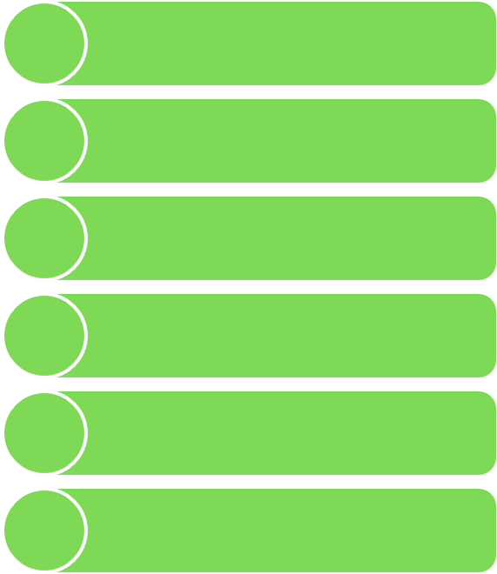


6-4 Months Out
08. Determine size of the event.
FCPA categorizes any event with less than 500 attendees as a small event. Please see the large event presentation if you have more than 500+ attendees.
Large Events
Small Events
4-H Carnival
Easter Egg Hunts
4th of July Celebrations
Employee Appreciation
Earth Day Celebration
Picnics
Sully Car Show
Volunteer Appreciation Night
Park Services | Fairfax County Park Authority | 6
Notes:
Throughout the completion of these steps, you may find yourself wondering if it may be necessary to upgrade the size of your event. If that’s the case, please see the large event presentation if you believe you’ll have over 500 attendees. This chart references the events FCPA has produced in the past and which category they would fit.

Slide 8


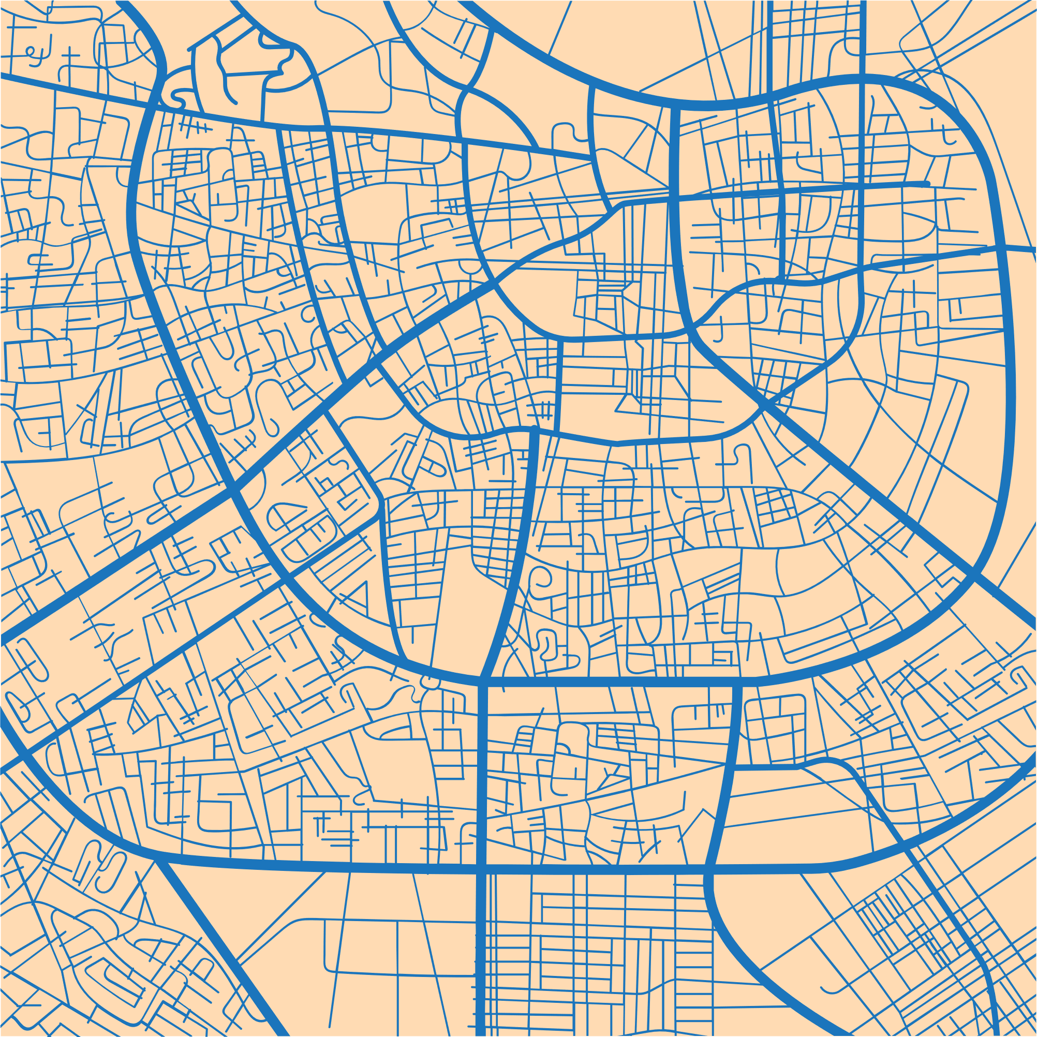
3 Months Out
01. Finalize dates with your manager.
Make sure the dates are cleared by your manager. If you need to change the time or location of your event, let your manager know.
02. Do a site visit and determine safety exits.
To ensure that your site plan is accurate, please conduct a site visit. Meet with the site manager (if applicable). Determine emergency exits and evacuation routes.
03. Outline event layout and site plan.
Outline the location of the bathroom facilities, electrical equipment, programming and entertainment, and other necessary equipment for the event. Make sure to plan for first aid. Plan for EMS if necessary.
Park Services | Fairfax County Park Authority | 7
Notes:
Now that you are 3 months out, finalize the date with your manager. Once you know that you’ve successfully secured your location, meet with a staff member for a site visit. Then you are able to make an event layout and site plan. Outline the location of the bathroom facilities, electrical equipment, and other necessary equipment for your event. Determine the flow of attendees and how to make the event safe and accessible for everyone. Make sure to determine the location of your emergency exits, first aid placement, and develop an emergency action plan. Plan for EMS if necessary.

Slide 9
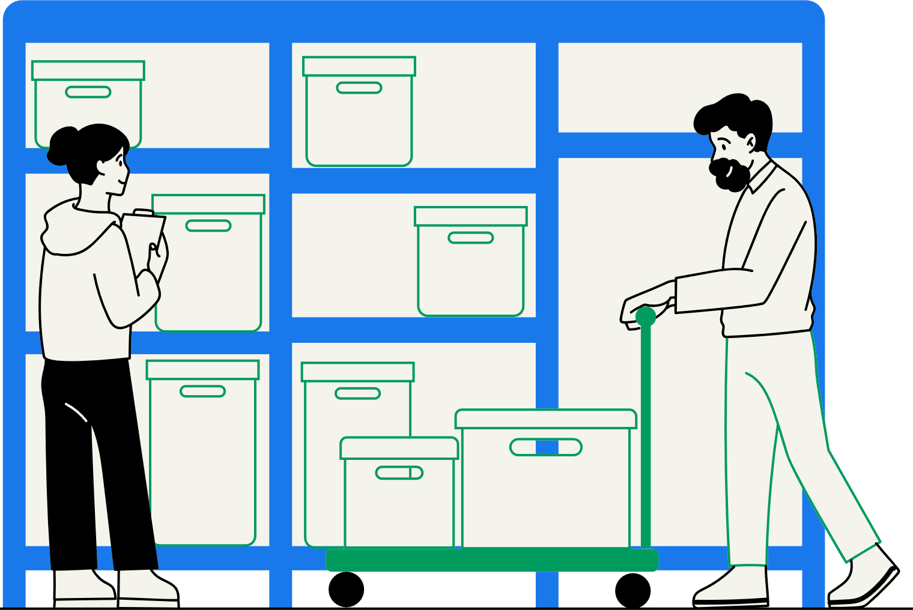

3 Months Out
04. Order all necessary equipment.
Order any and all equipment and supplies needed for the event. If you need equipment from FCPA’s Special Events Inventory, please use the checkout form: https://forms.office.com/g/0ddiZw99HC. The FCPA Special Events Inventory sheet includes equipment and items that are available to borrow for your event. All submissions will go through Shera White for approval.
05. Book vending and entertainment (if needed).
Make sure to research and contact any entertainment options as necessary. Email food truck vendors, send out contracts, and get any necessary permits from the vendors. Make sure the food vendors work in partnership with the FCPA Permits office.
Park Services | Fairfax County Park Authority | 8
Notes:
Create your equipment list and determine what vendors you will use. You can check out Special Events equipment from the FCPA Events Department using this link (click on the link in the presentation).
You should also make sure to book all vending and entertainment. Research different options and have some as backup vendor and entertainment options to make sure all your bases are covered.

Slide 10
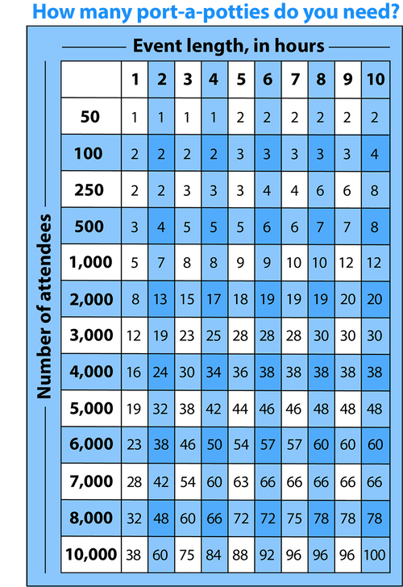
3 Months Out
06. Plan for bathroom facilities.
FCPA and OSHA Sanitation Standards require for there to be a minimum of four bathroom facilities (and one handicap facility) for events with 500+ attendees over two hours. If your event plan requires the addition of portable bathroom facilities, please see the chart below.
Park Services | Fairfax County Park Authority | 9
Notes:
Refer to this chart if you need extra bathroom facilities (point to the chart).

Slide 11

3 Months Out
07. Report the necessary updates of your event plan to your manager.
Communicate with your manager regarding the status of your event plan.
Event Plan - Required
Review the event plan with your manager once completed.
Emergency Action Plan
The approved plan must be submitted 30 days before the event.
Charitable Gaming Business Activity License (if applicable)
Complete at least 45 days before the event.
Receive Food Vendor Certificates of Insurance and Health Department Permits
Alcohol Beverage Request Form (if applicable)
Complete within 30 days of your event.
Virginia ABC Banquet License (if applicable)
Complete within 30 days of your event.
Operational Permits, Fire and Rescue (if applicable)
Complete within 30 days of your event.
Amusement (AMUSE) Device Application (if applicable)
Complete within 30 days of your event.
Park Services | Fairfax County Park Authority | 10
Notes:
Report the necessary updates of your event plan to your manager. Communicate with your manager regarding the status of your event plan. All of the other files on this list have a link embedded in the title of the file, click on it to access the file application.

Slide 12


2 Months Out
01. Design a show flow.
Include who on your team is going to do what during the event. Make another list with other roles and responsibilities for your on-site team.
Make sure you are able to answer these questions:
  Who will be responsible for set-up and take-down?
  Who will bring the refreshments/decorations?
  Who will be managing crowd control/ticketing guests at entrance?
  Who will be the main contact for the entertainment/vendors?
02. Finalize parking plans.
Who will be managing parking the day of the event? Does your event require overflow parking? If overflow parking is required, identify the correct point of contact for the desired location and begin coordinating efforts.
Park Services | Fairfax County Park Authority | 11
Notes:
With two months out, you should design a show flow that’ll list who on your team will be doing what tasks during the event. Make sure you are able to answer these questions here (point to the blue box). Finalize your parking plans and make sure that if your venue does not have enough parking, that you plan for overflow.

Slide 13

1 Month Out
01. Monitor your registrations.
Answer questions from vendors, contracted services and attendees as they come in.
02. Schedule a meeting with your event team.
Review roles and responsibilities and the show flow to ensure that everyone is on the same page. Share event-day contact information amongst the team.
03. Prepare remarks.
Prepare remarks that can be used for interviews and other opportunities presented to acknowledge sponsors, contributors, and volunteers.
04. Ensure the fliers and programs are edited and distributed properly.
Make sure that if you make a flier or program that you have it proofread for any errors. Always doublecheck that the names of VIP’s, sponsors and entertainers are spelled correctly.
Park Services | Fairfax County Park Authority | 12
Notes:
At one month out, monitor your registrations, schedule a meeting with your event team, write your introduction and closing remarks, and ensure the fliers and programs are edited and distributed properly.

Slide 14



2-1 Week(s) Out
01﻿. Finalize confirmations.
Are all of the vendors and entertainers confirmed for the event? Are payment methods in place? Make sure to send correspondence to everyone involved in the event, including arrival information, the site plan, and FAQs to minimize confusion during the event.
02. Monitor your registrations.
Consider adjusting your event plan if your attendance will be lower than expected.
03. Monitor the weather.
Make sure to keep updated on any possible weather conditions that may affect the site plan and the attendance of the event. Try exploring programming alternatives.
04. Work through any expected equipment delays.
If you are facing any equipment issues, work with your manager to explore possible solutions or alternatives.
Park Services | Fairfax County Park Authority | 13
Notes:
Finalize confirmations 2-1 week(s) out. Make sure the vendors and entertainers are all set for the event. Make sure they know when the arrival and departure times are. Make sure to send everyone involved with the event a show flow, including FCPA staff, vendors, volunteers, and any other people helping out the day of the event. Make sure to continuously monitor the weather and work through any equipment delays. Ask your manager for resources.

Slide 15
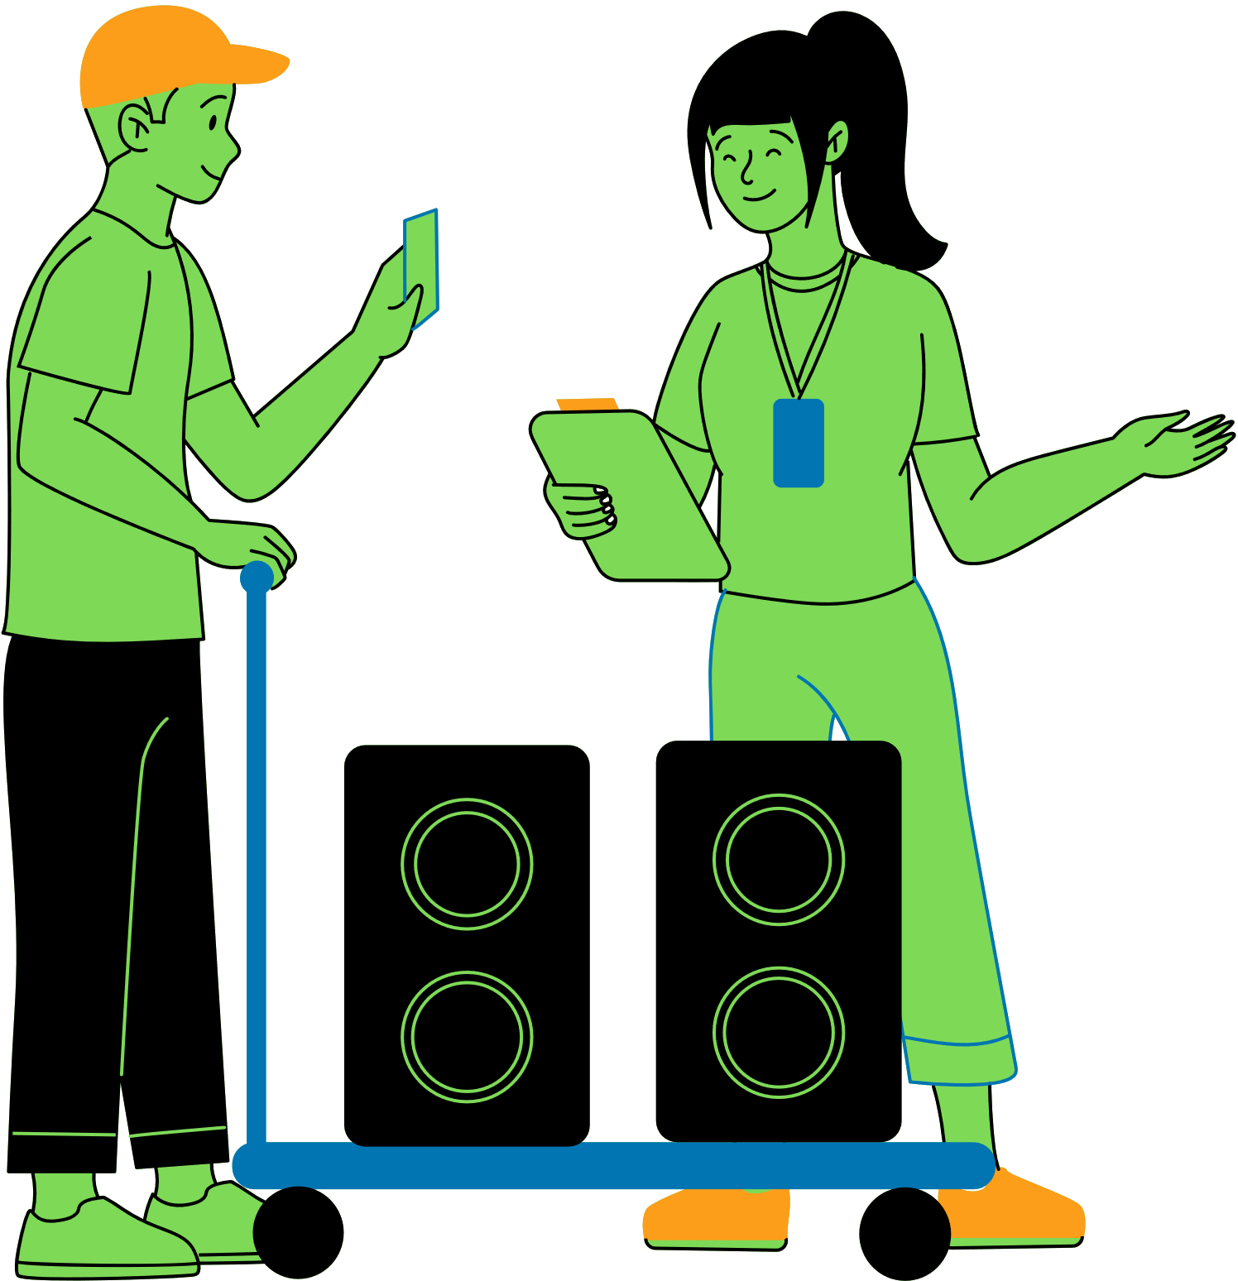
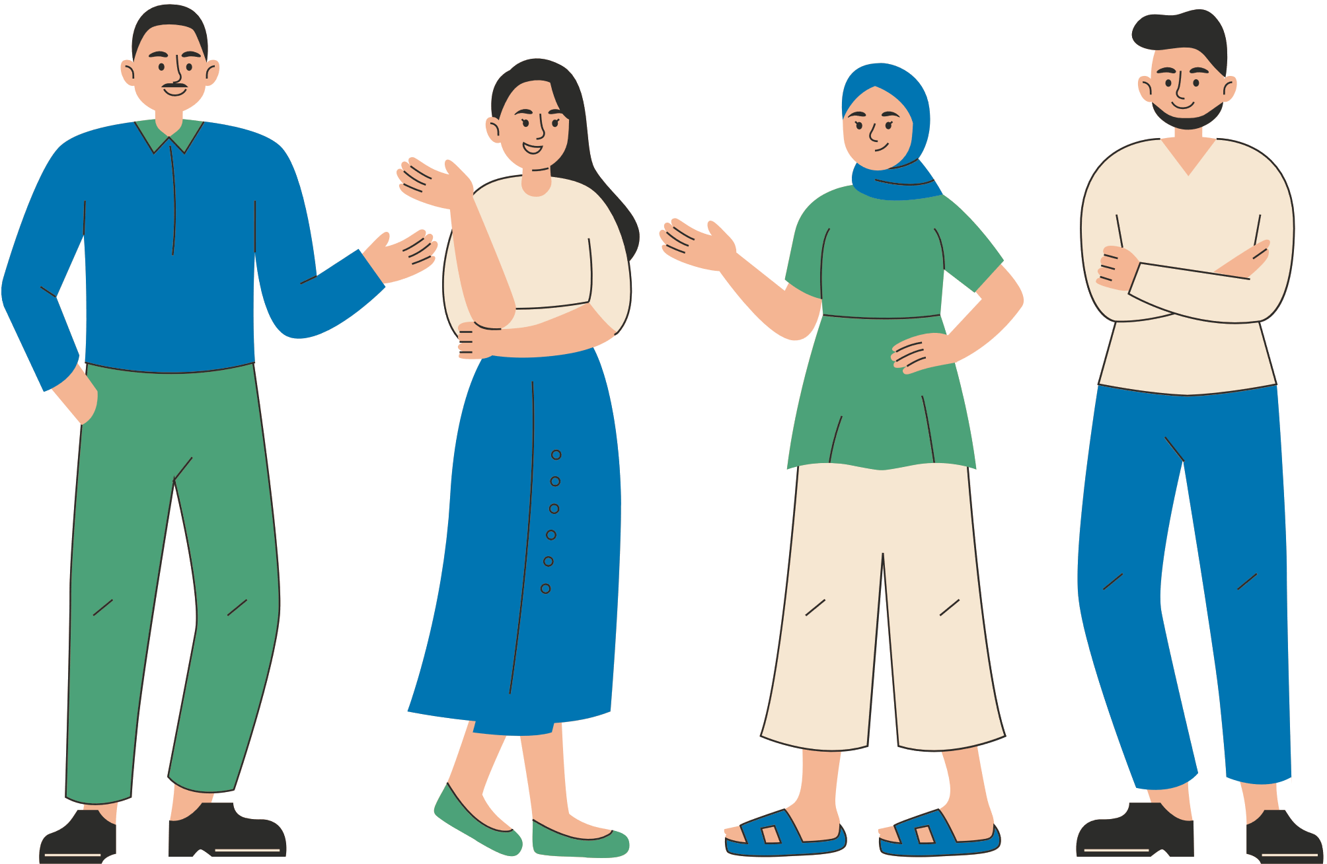
Day of the Event
01. Continue to monitor the weather.
Make sure to keep updated on any possible weather conditions that may affect execution of the event. Since many FCPA venues are outdoors, if inclement weather occurs, it may be necessary to make an onsite determination to cancel the event.
02. Set up your event based on your site plan.
If you are facing any unexpected equipment issues or layout challenges, be open to making on-the-spot changes.
03. Monitor your guests.
Make sure you are monitoring the attendees. Use this as an opportunity for community engagement. If the event exceeds capacity, make adjustments to accommodate.
Park Services | Fairfax County Park Authority | 14
Notes:
Continue to monitor the weather, set up your event base on your site plan and show flow. If there are any changes, contact your team. Make sure you are monitoring the attendees. Use this opportunity for community engagement. Make sure there’s no damage done to FCPA property and make adjustments to accommodate guests if the event exceeds capacity.

Slide 16

Debrief
Congratulations! You have planned your FCPA event! It’s good practice to poll the planning team and other involved parties for a post-event evaluation.
Park Services | Fairfax County Park Authority | 15
Notes:
Congratulations on completing your event! Now is the time to take a breath and reflect on what you and your team did well and on what you are your team could have done better. It’s good practice to poll the planning team and other involved parties for a post-event evaluation.

Slide 17
Acknowledgements
This guide was brought to you by Fairfax County Park Authority’ Park Services Division and the Special Events team.
  Shera White, Events and Volunteer Manager
  Mariechu Rovira, Special Events Intern
  Leah Shosteck, Special Events Intern
If you want more information about planning event with FCPA, please feel free to connect with us!
Contact
Shera White
shera.white@fairfaxcounty.gov
Park Services | Fairfax County Park Authority | 16
Notes:
Please contact Shera White if you have any more questions about planning an FCPA event.

